Slide 1
Ultra-Long-Range Weather Data

Slide 2
Executive Summary
Weather 20/20’s ultra-long-range weather forecast technology helps businesses with weather-sensitive products, services, distribution, and supply chains accurately predict market demand months in advance, allowing for accurate logistical and distribution planning, higher margins, and better ROI.

Slide 3
The Problems We Solve
Accurate & Effective Data!
Our patent-pending weather model provides the data & our team provides the weather & business intelligence!
For weather-dependent products, services, distribution, and supply chains predicting product-market demand can feel like making a guess in the dark.
Weather can cause unforeseen logistical and distribution disruptions.
Businesses attempt to plan product distribution six-months out only to realize, when the day comes, their products are in the wrong place at the wrong time and they’re losing sales.

Slide 4
The Lezak Recurring Cycle (LRC)
Based on 75 years of meteorological research, the LRC allows for highly-accurate weather forecasting 15-300 days out so you can make informed logistical decisions that affect revenue.
The LRC® weighs in astronomical & ocean/land temperature insights to input into the model to produce actionable & effective/accurate data and create the “The Snapshot”. The ”sweet spot of accuracy is from January –September!
As the LRC® is established, accuracy increases as the model learns, improve and more data becomes available
# Days determined
64-Days This Year
Cycling Pattern Established Cycle 2, 3, 4, 5, & 6 Projected
Effective & accurate data is available to input into your analytics
Severe weather outbreaks - Hurricane disasters - Floods - Heat Waves - Other impacting weather events predicted accurately from weeks up to 11-months before the disaster strikes
A unique pattern sets up every year after the sun sets at the North Pole on the Autumnal Equinox
A cycle length evolves and is set by December and the pattern cycles through the next September
Anchor troughs and ridges become established and the stormiest and driest regions are determined, where storm systems will reach their strongest and weakest points

Slide 5
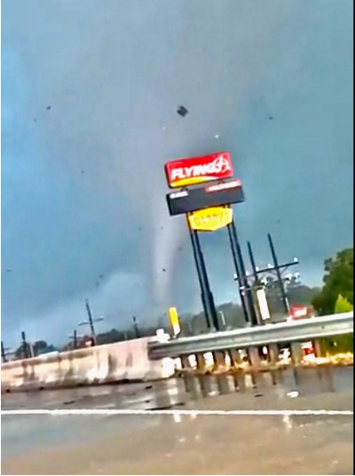
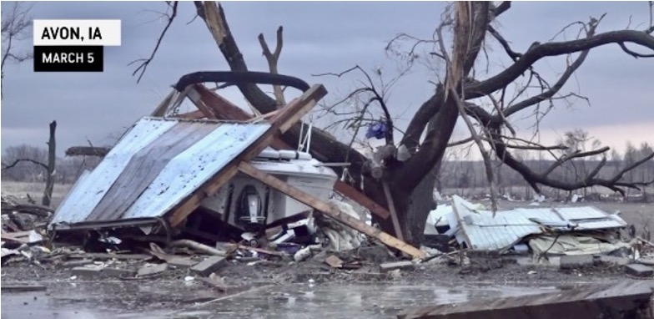
Why it’s important that we know when, where, & who (client) a severe weather event will happen
Crossing I-10 near TX/LA border - October 27, 2021
Iowa Tornado March 5, 2022 (129 days or a 64-day-cycle (7 People Killed)
This is NOT a coincidence! It is predictable accurately far in advance (weeks to months)
When the severe weather outbreak happened on October 27th, it is then predictable for the pattern to return when the LRC cycle length is determined, so around March 5th, and now May 8th
This also means that the patent-pending model is reliable, accurate, and the data is useful for your company to add into your business analytics, which we will look at in a live demo

Slide 6
Long-Range Weather Alert
Significant severe weather happened in the first two cycles of this year’s pattern, which increases the probability of nearly 100% that a major severe weather outbreak will happen in at least one of the next three cycles.
Past Severe Weather Outbreaks
Oct 9 - 13, 2021
Future Severe Weather Outbreaks,
as forecasted using The LRC
Feb 15 - 18, 2022
Oct 9 - 13, 2021\]
Dec 10 - 15, 2021
April 16 - 24, 2022
Most likely to be the most severe outbreak.
June 20 - 28, 2022

Slide 7
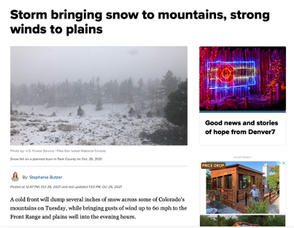
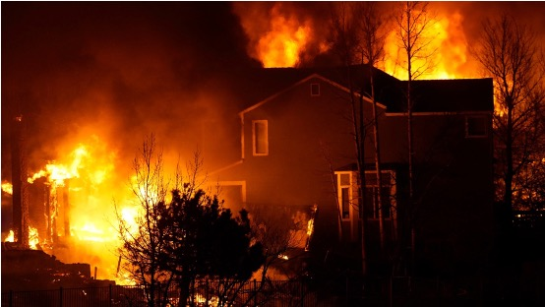
Long-Range Weather Alert
Boulder County, CO had a major fire disaster in early 2022 caused by a high wind event. The part of the weather pattern that produced the high winds will return. We predict potential power outages, dust storms, and fires.
Past High Wind Events
Dec 30, 2021 - Jan 1, 2022
Future High Wind Events,
as forecasted using The LRC
Mar 3, 2022
Oct 9 - 13, 2021\]
May 5, 2022

Slide 8
Significant Weather Alert - High Wind Event
December 10-15
Boulder County, CO had a major fire disaster that was caused by a high wind event
The part of the pattern that produced the high winds will return around March 3, 2022, and May 5th, 2022
Impact Prediction: Power Outages, Dust Storms, & Possibly Fires Again

Slide 9
Our Technology Stack
A continuous, global, ultra-long-range weather data feed added to your enterprise’s data warehouse. Allows analysts to compare & correlate your proprietary datasets with weather data and model weather’s past & future impact on business outcomes.
Ultra-Long-Range Weather Data Platform
Enables users to visualize curated ultra-long-range weather datasets from our global weather data warehouse, including forecasts and historical weather data, and understand the significance of weather trends on business outcomes.
Ultra-Long-Range Weather Dashboard Tool
Ultra-Long-Range Weather Forecast API
Powers your internal applications with ultra-long-range weather data. Enables applications to access global weather data in milliseconds.

Slide 10
Benefits
Data-informed logistical & distribution decisions
More accurate prediction
of market demand
Reduced internal demands,
time & energy saved
Higher margins, better ROI

Slide 11
Weather 20/20 Customer Success
Doug Yoder
Tad Trout
Michael Collar
Mike Mason
Executive Director,
Shopper & Category Insights
“In the past four years Elanco has been developing models incorporating Weather 20/20’s LRC model weather data, resulting in a 3% to 7% impact on $4B yearly revenue, totaling $120M - $280M.”
President
“We have been working with Weather 20/20 for three years now. Our products are being placed strategically now using these accurate weather forecasts months in advance.”
President
“It will blow your mind how accurate these forecasts have been over the past ten years working with Weather 20/20. The LRC has helped us to ship fireworks to locations that will have the best sales.”
Owner
“Weather is very important – it runs our business… Based on the long-range forecast for below-average snow for the entire winter, my company limited the amount of material we purchased for the winter season.”

Slide 12
Where Physics Fails
Statistics Prevails
Physics models can only approximate current atmospheric conditions for physics equations, leading to only approximations of outcomes
Errors compound with each passing hour
The forecasts past 10-days are highly inaccurate and unreliable
The LRC uses this year’s weather pattern and projects forecasts forward using a statistical pattern-based algorithm.
The LRC becomes more accurate as it phases out the “butterfly effect” of compounding errors due to approximated data
Ultra-Long Range Weather Data 20 to 200 days out are as accurate as a 7-day forecast in a typical weather app.

Slide 13
The LRC vs. Competing Solutions
 | The LRC Model | Enso | Sea Surface Temp | Global Climate Models
Forecast of when significant events will hit with months lead time (Severe outbreaks, tropical storms, major winter storms) | 60% to 90% accurate | Not capable of predicting events | Not capable of predicting events | No, likely wrong
Forecast of when & where the cold outbreaks & heat waves will occur | Reliable with 80%+ accuracy | Not capable of predicting when | No, impossible to do | No, it will be at least a few weeks off and likely wrong
30-day to 90-day weather forecasts | Excellent accuracy (>80%) | Some accuracy | Some accuracy | Likely wrong
Drought/flood predictions | Excellent accuracy (>80%) | Not capable of predicting when | Impossible to do | Likely wrong

Slide 14
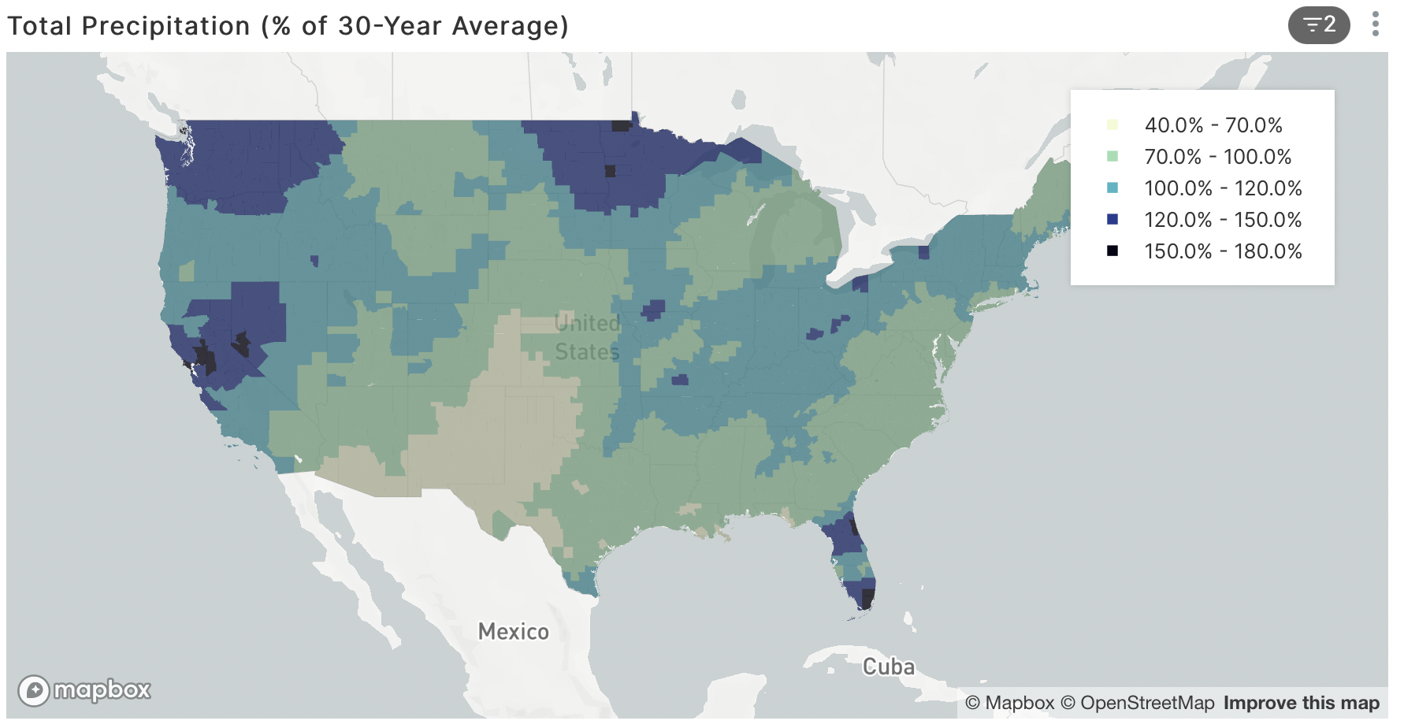
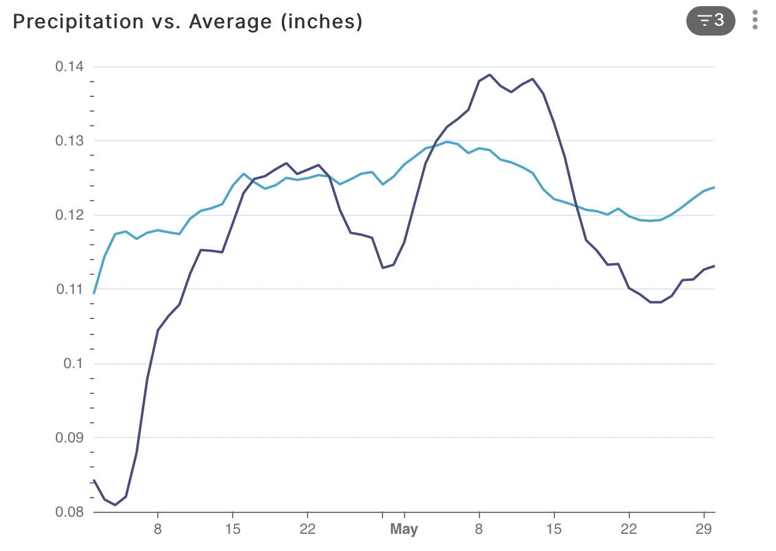
Dashboard output from the LRC-patent-pending weather model (100-day predictions as accurate as the 7-day is on your weather app!
April 1- May 30, 2022 Prediction
The model is global, accurate, effective!

